Slide 1
Lecture 9.2 – OpenStack & Comparing and Contrasting AWS with NeCTAR Cloud Professor Richard O. Sinnott & Farzad Khodadadi University of Melbourne rsinnott@unimelb.edu.au

Slide 2


&
UniMelb/NeCTAR Research Cloud
open source Cloud platform
openStack
overview of the major services*
AWS (http://aws.amazon.com)
mainstream Cloud platform
Examples of the kinds of services that are available
*note that not all openstack services are available (yet!?) on the NeCTAR Research Cloud

Slide 3
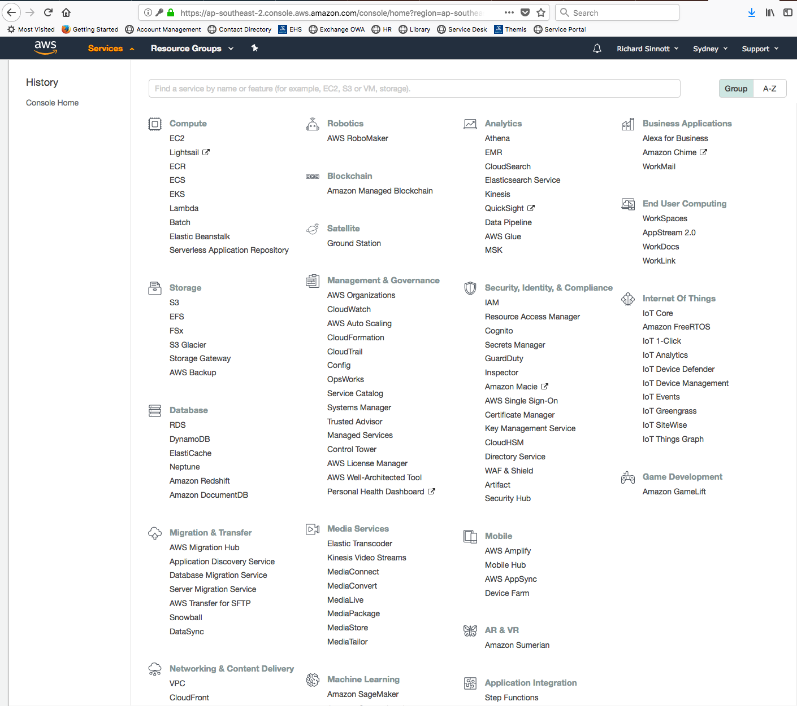
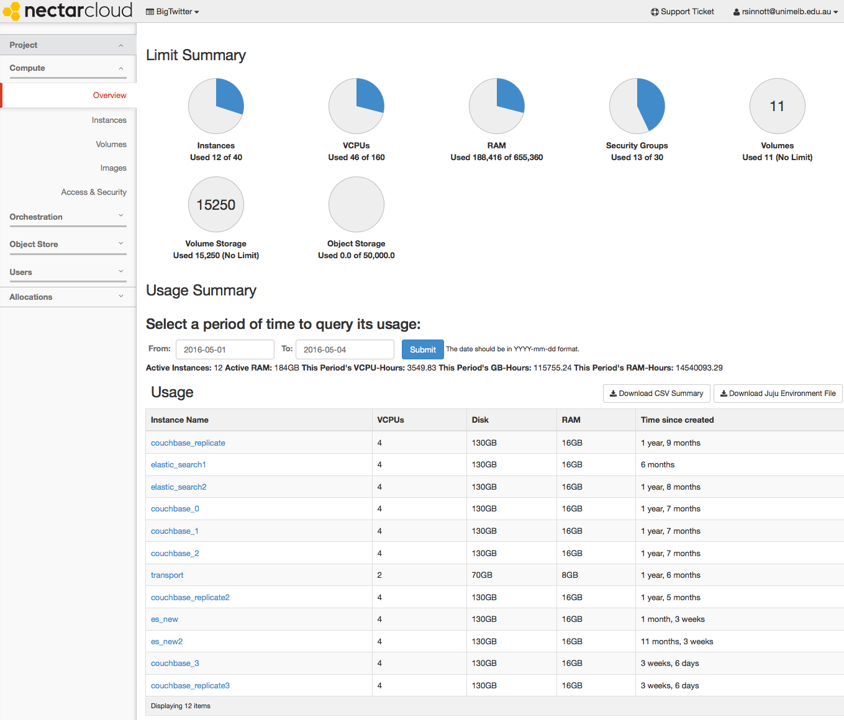
&

Slide 4
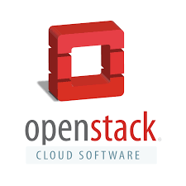
OpenStack
Began in 2010 as a joint project between Rackspace and NASA
Offers free and open-source software platform for cloud computing for (mostly) IaaS
Consists of interrelated components (services) that control / support compute, storage, and networking resources
Often used through web-based dashboards, through command-line tools, or programmatically through ReSTful APIs
Released under the terms of the Apache License
Managed/coordinated by the OpenStack Foundation
non-profit corporate entity established in 2012 to promote OpenStack software and its community
Over 500 companies have since joined the project

Slide 5
OpenStack Components
Many associated/underpinning services
Compute Service (code-named Nova)
Image Service (code-named Glance)
Block Storage Service (code named Cinder)
Object Storage Service (code-named Swift)
Security Management (code-named Keystone)
Orchestration Service (code-named Heat)
Network Service (code-named Neutron)
Container Service (code-named Zun)
Database service (code-named Trove)
Dashboard service (code-named Horizon)
Search service (code-named Searchlight)
…
https://www.openstack.org/software/project-navigator/openstack-components#openstack-services

Slide 6
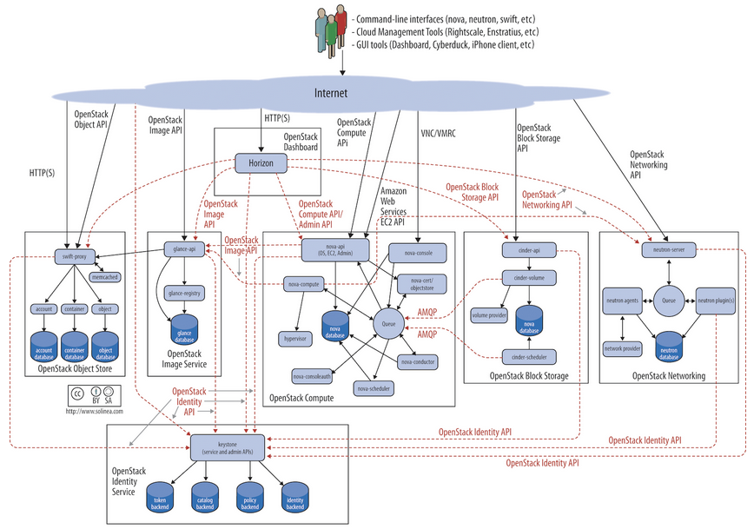
(Simplified) OpenStack Architecture
Components realised as APIs, Services, Daemons, Clients, …

Slide 7
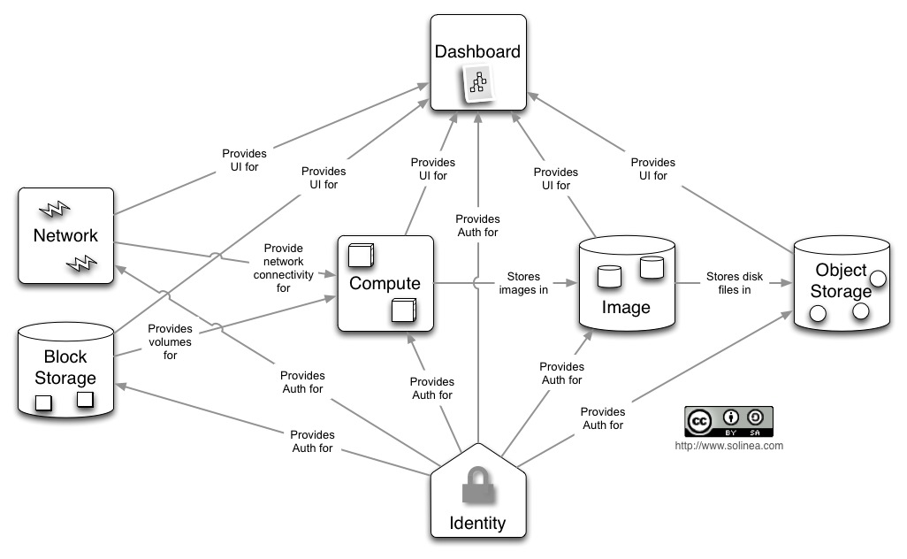
(Simplified) User Perspective
Typically asynchronous queuing systems used (AMQP)

Slide 8
Key Services::Identity Service
Keystone
Provides an authentication and authorization* service for OpenStack services
Tracks users/permissions
Provides a catalog of endpoints for all OpenStack services
Each service registered during install
Know where they are and who can do what with them
Project membership; firewall rules; image mgt; …
*Generic authorization system for openStack…
more in next lecture

Slide 9
Key Services::Compute
Nova
Manages the lifecycle of compute instances in an OpenStack environment
Responsibilities include spawning, scheduling and decommissioning of virtual machines on demand
Virtualisation agnostic
Libvirt
open source API, daemon and tools for managing platform virtualisation including support for Kernel based virtual machine (KVM), Quick Emulator (QEMU), Xen, Lightweight Linux Container System (LXC)
XenAPI, Hyper-V, VMWare ESX,
Docker (more later from Luca)
…

Slide 10
Key Services::Compute
Nova
API
Nova-api - accepts/responds to end user API calls; supports openStack Compute & EC2 & admin APIs
Compute Core
Nova-compute - Daemon that creates/terminates VMs through hypervisor APIs
Nova-scheduler - schedules VM instance requests from queue and determines which server host to run
Nova-conductor - Mediates interactions between compute services and other components, e.g. image database
Networking
Nova-network - Accepts network tasks from queue and manipulates network, e.g. changing IPtable rules
Image Mgt, Client Tools, …

Slide 11
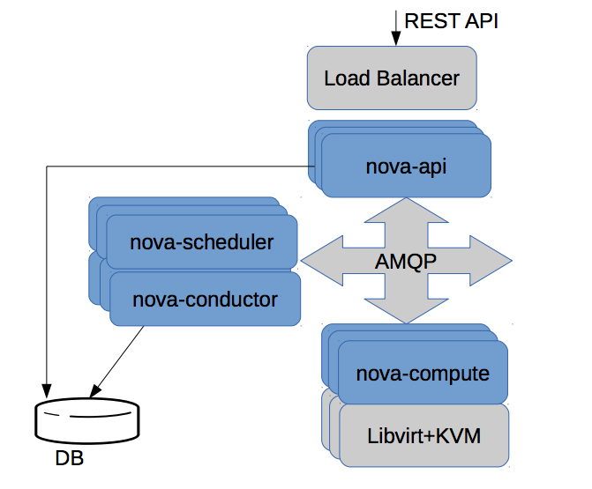
Simplified (Scalable) Nova Architecture
I need a VM with:
64Gb memory,
8vCPUs,
in Melbourne,
running Ubuntu 12.04,
…

Slide 12
Key Services::Object Storage
Swift
Stores and retrieves arbitrary unstructured data objects via RESTful API, e.g. VM images and data
Not POSIX (atomic operations); eventual consistency
Fault tolerant with data replication and scale-out architecture.
Available from anywhere; persists until deleted
Allows to write objects and files to multiple drives, ensuring the data is replicated across a server cluster
Can be used with/without Nova/compute
Client; admin support
e.g. Swift client – allows users to
submit commands to ReST API through
command line clients to configure/
connect object storage to VMs

Slide 13
Key Services::Block Storage
Cinder
Provides persistent block storage to virtual machines (instances) and supports creation and management of block storage devices
Cinder access associated with a VM
Cinder-api – routes requests to cinder-volume
Cinder-volume – interacts with block storage service and scheduler to read/write requests; can interact with multiple flavours of storage (flexible driver architecture)
Cinder-scheduler – selects optimal storage provider node to create volumes (ala nova-scheduler)
Cinder-backup – provides backup to any types of volume to backup storage provider
Can interact with variety of storage solutions

Slide 14
Key Services::Image Service
Glance
Accepts requests for disk or server images and their associated metadata (from Swift) and retrieves / installs (through Nova)
Glance-api – image discovery, retrieval and storage requests
Glance-registry – stores, processes and retrieves metadata about images, e.g. size and type
Ubuntu 14.04…?
My last good snapshot…?

Slide 15
Key Services::Networking
Neutron
Supports networking of OpenStack services
Offers an API for users to define networks and the attachments into them, e.g. switches, routers
Pluggable architecture that supports multiple networking vendors and technologies
Neutron-server – accepts and routes API requests to appropriate plug-ins for action
Port management, e.g. default SSH, VM-specific rules, …
More broadly configuration of availability zone networking, e.g. subnets, DHCP, …

Slide 16
Key Services::Dashboard
Horizon
Provides a web-based self-service portal to interact with underlying OpenStack services, such as launching an instance, assigning IP addresses and configuring access controls.
Based on Python/Django web application
Mod_wsgi
Apache plug realising web service gateway interface
Requires Nova, Keystone, Glance, Neutron
Other services optional…

Slide 17
Key Services::Database Service
Trove
Provides scalable and reliable Cloud database (DBaaS) functionality for both relational and non-relational database engines (for the masses!)
Resource isolation, high performance, automates deployment, config, patching, backups, restores, monitoring…
e.g. Set up 3 VMs with mySQL, CouchDB, MongoDB
Use image service for each DB type and trove-manage to offer them to tenants/user communities

Slide 18
Key Services::Data Processing Service
Sahara
Provides capabilities to provision and scale Hadoop clusters in OpenStack by specifying parameters such as Hadoop version, cluster topology and node hardware details
User fills in details and Sahara supports the automated deployment of infrastructure with support for addition/removal of worker nodes on demand

Slide 19
Key Services::Orchestration Service
Heat
Template-driven service to manage lifecycle of applications deployed on Openstack
Stack: Another name for the template and procedure behind creating infrastructure and the required resources from the template file
Can be integrated with automation tools such as Chef, Puppet, Ansible, etc.
Template format:
JSON (similar to Amazon's CloudFormation)
YAML
(HOT)

Slide 20
Key Services::Orchestration Service
Heat details
heat_template_version: allows to specify which version of Heat, the template was written for (optional)
Description: describes the intent of the template to a human audience (optional)
Parameters: the arguments that the user might be required to provide (optional)
Resources: the specifications of resources that are to be created (mandatory)
Outputs: any expected values that are to be returned once the template has been processed (optional)

Slide 21
Creating Stacks in NeCTAR
Create the template file according to your requirements
Provide environment details (name of key file, image id, etc)
Select a name for your stack and confirm the parameters
Make sure rollback checkbox is marked, so if anything goes wrong, all partially created resources get dumped too
Wait for the magic to happen!

Slide 22
Demonstration of HEAT
Creating a Wordpress website NeCTAR-style
Creating a Wordpress website AWS-style

Slide 23
References
NeCTAR sample template repository
(https://github.com/NeCTAR-RC/heat-templates)

